Slide 1
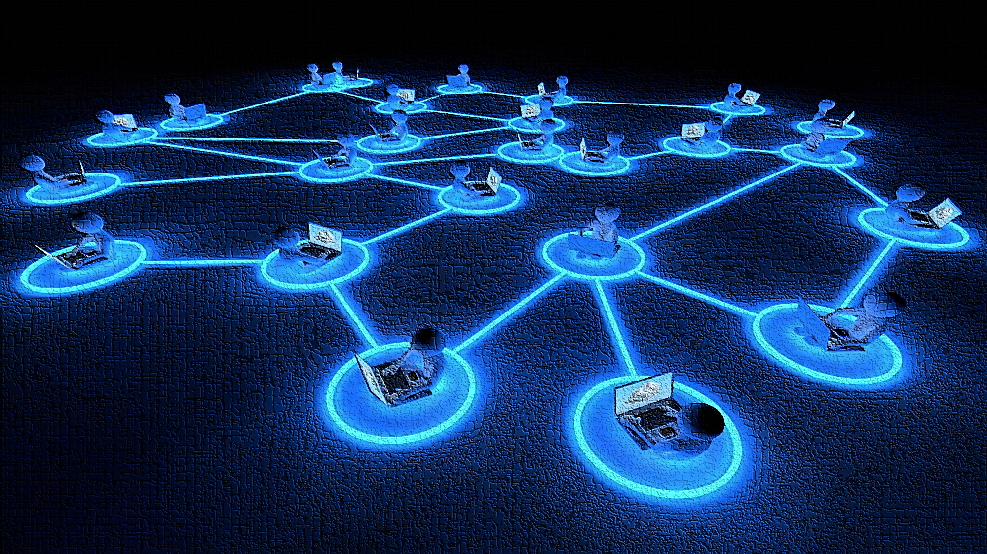



NEVER MISS A REFERRAL OPPORTINITY AGAIN!
Trusted Referrals...
Delivered at the SPEED and NEED of the Consumer!

Slide 2
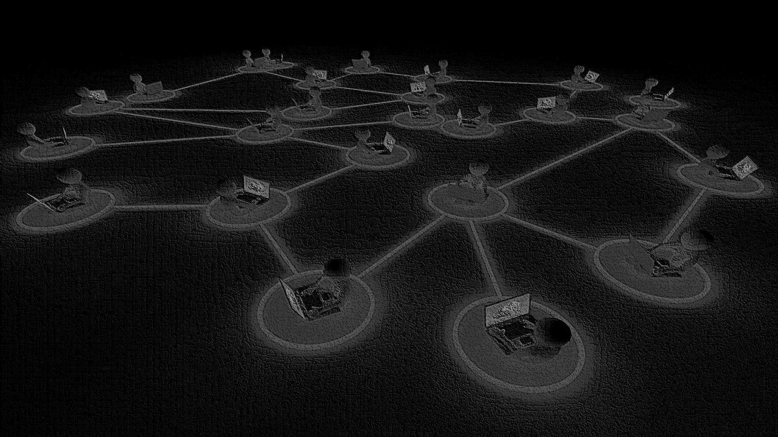
General Information
Be sure to sign-in for Broker Approved Training Credit!
Pick up course materials
Turn off ringers on mobile phones & PDA’s
Stay awake…or I’ll ask you a question

Slide 3
Why NETWORKING works?
YOUR Long-term success
is in direct proportion to the size, quality and effectiveness of your personal referral network!

Slide 4
Unproductive ‘Traditional’ NETWORKING tactics
BUSINESS CARDS
BOOZE
BLARNEY
What usually happens to all those stacks of cards you collect at networking events?

Slide 5
Networking Fact #1
The people and contacts you know…
and those that know and trust you...
have the potential to be your best source of ongoing business...
ONCE YOU BECOME AN EFFECTIVE NETWORKER!

Slide 6
Networking Fact #2
Consumers now have the power to make or break a business…instantly…in person, on social media... and online!
Choose your “trusted referrals” wisely!

Slide 7
Networking Perspective
CRM vs CRN
Customer Relationship Management (CRM) is a technology for “managing” all your relationships and interactions with customers and potential customers.

Slide 8
Networking Perspective
CRM vs CRN
Customer Referral Network (CRN) is a collection of trusted business individuals, all set on generating each other new business via word-of-mouth and referrals while providing top-quality services worthy of referral.

Slide 9
3-W’s & 1-H of Networking
It’s not WHAT you know – but it helps
It’s not WHO you know – but they can help
It’s NOT even WHO KNOWS YOU – but it can matter
It is NOW, ALWAYS about
HOW DO THEY KNOW YOU?
—Trust goes a long way!

Slide 10
Networking R.O.I. by the numbers
1.5% ... 3.2% ... 18% ... 68%

Slide 11
Networking R.O.I. by the Word
Referral and word-of-mouth marketing tend to be much more targeted because people usually know their friends and social audiences pretty well. This allows your brand message to spread more effectively than with most other marketing channels.

Slide 12
Exponential Networking
Reach and Acceleration
For the most part… traditional marketing was limited to the number of people you came in direct contact on any given day.
365
730
1095

Slide 13
leveraged Referral Networking
In this day and age, the professionals' reach can be much larger for people who efficiently and effectively leverage the SOI networks of others through their “trusted referrals” networks!
365 +
730 +
1095 +

Slide 14
Networking results
INCREASED
REFERRALS

Slide 15
The future of successful networking…
Businesses of tomorrow will require a much greater emphasis on referral networking. In our technologically enhanced society, intelligently designed software has augmented human ability to be productive and successful at a faster pace than every before. Thus, relying more on individual relationships and the delivery speed of the trusted referral.

Slide 16
Network methodologies
CHASE Traditional
ATTRACT Old-School
RECIPROCATE Contemporary

Slide 17
Traditional Chase networking…
Events
Print Advertising/Billboarding
Emails
Internet leads...& Cold Calls
Unscheduled visits

Slide 18
Old-School attract networking…
Educate
To “out-network” your competitor
you must first create a process to“out-educate” your competitor!

Slide 19
Contemporary Reciprocal networking…
To “GET referrals”…
...“GIVE referrals”!

Slide 20

networking Problems
Credibility
Second-Hand Referrals
Client loss
Organize
Maintain
EXPANSION

Slide 21
Networking solution
NOW you can simplify the management, delivery, and experience of sharing trusted
Person-to-Person referral connections across your entire business network.

Slide 22
Key points...
NEVER MISS A REFERAL OPPORTUNITY AGAIN!
FREE to your Trusted Referrals and referral customers
NO CUSTOMER LOGIN REQUIRED
More secure that social media and NO embedded or competing ads
Includes a personally branded web page w/SEO benefits (Google, Bing, Yahoo!, etc.)

Slide 23
Key points...
NOTHING TO DOWNLOAD OR INSTALL
27/7/365 direct access to your Trusted Referrals
User-friendly on all devices... Computers, tablets, mobile phones
NO referral category restrictions
Excellent value! After you initial registration...you can manage your entire referral network for just $97/year

Slide 24
Wrap Up
Recognize the NEED
Referral collaborators achieve common goals.
Understand the VALUE
“Missed opportunities to engage with your audience, is missed revenue.
Be PROACTIVE
Nothing ventured, NOTHING gained.

Slide 25
NEVER MISS A REFERRAL OPPORTINITY AGAIN!
Trusted Referrals...
Delivered at the SPEED and NEED of the Consumer!

